Slide 1
AutoEncoder ( 6 )
2021. 8. 11.
박태정

Slide 2
내용
Network Packet Data Anomaly Detecting
AutoEncoder
Isolation Forest
Data set . CICIDS 2017

Slide 3
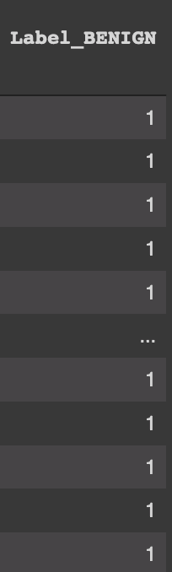
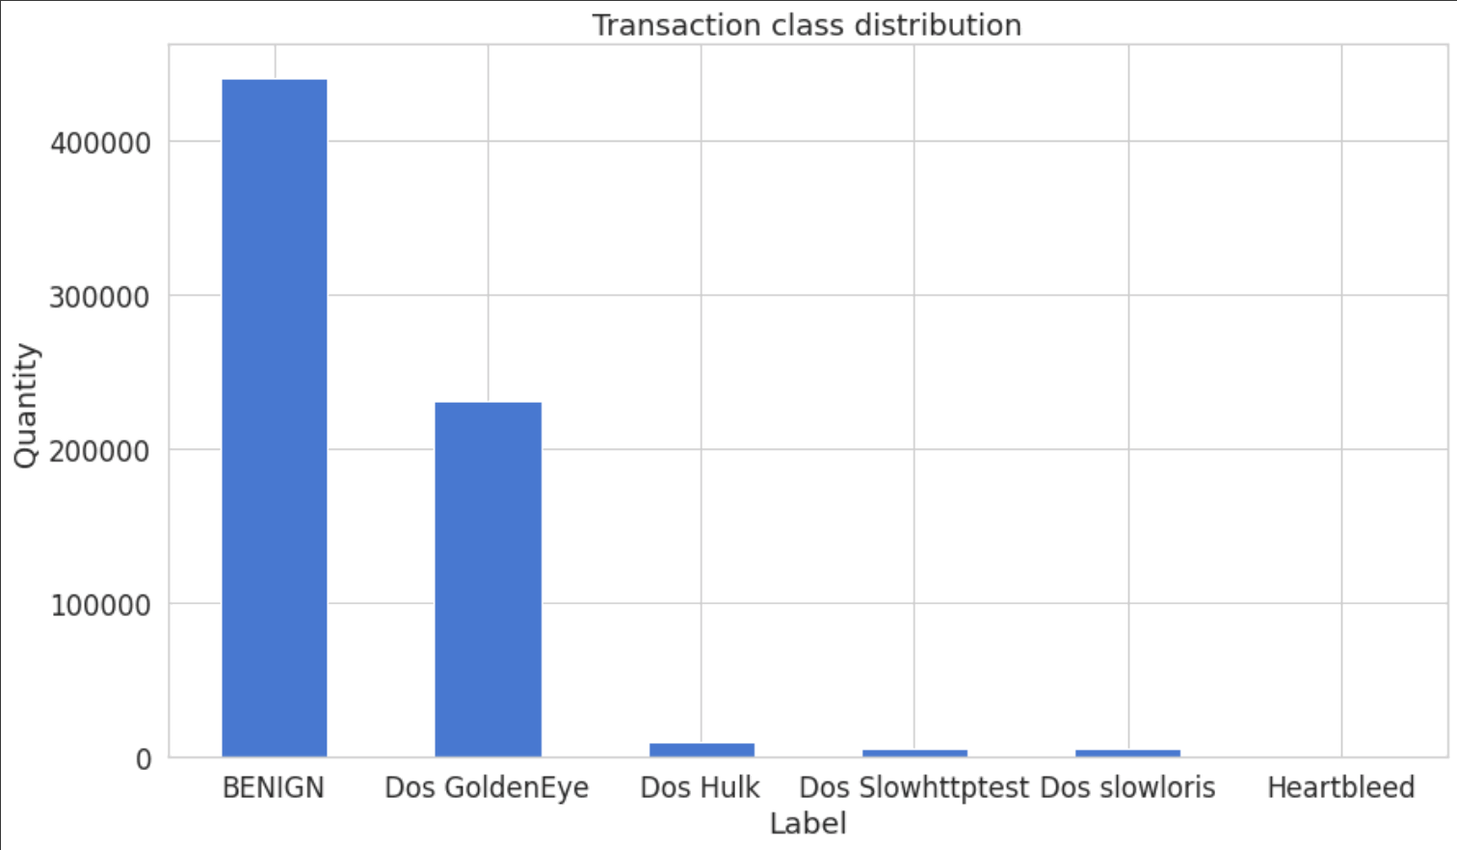

Network Flow Data Anomaly Detecting
데이터 전처리
One-Hot-Encoding

Slide 4
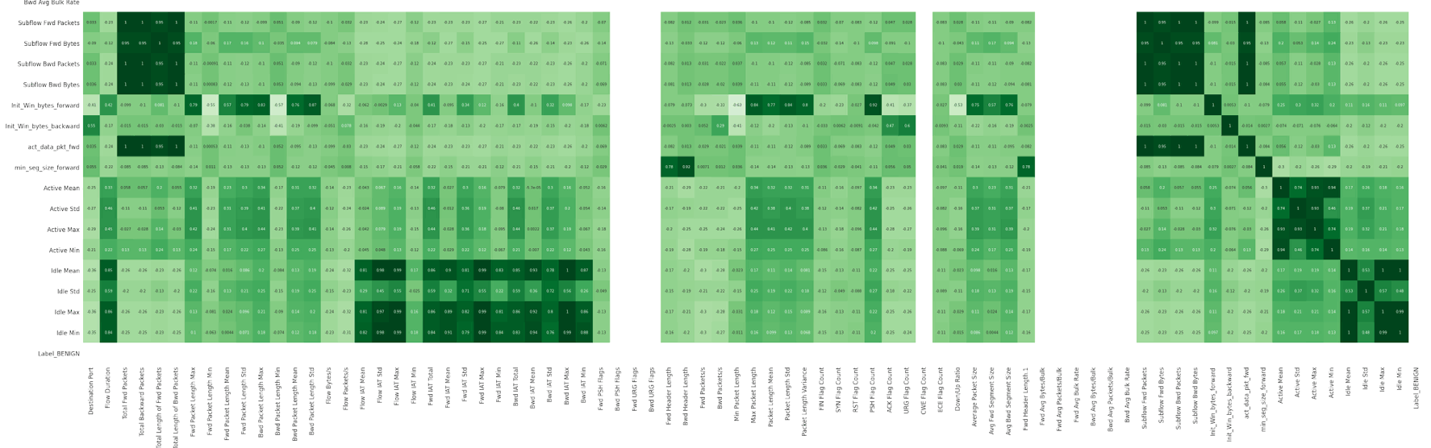
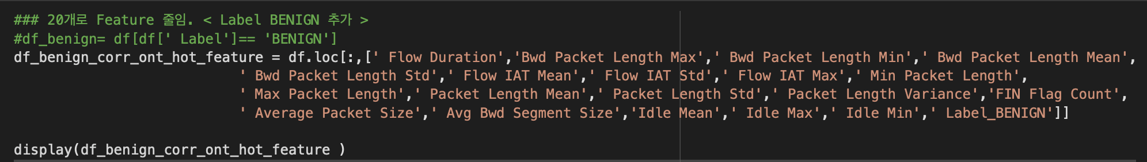
Network Flow Data Anomaly Detecting
데이터 전처리
Correlation 으로 78개 Feature 중 19개 추출

Slide 5
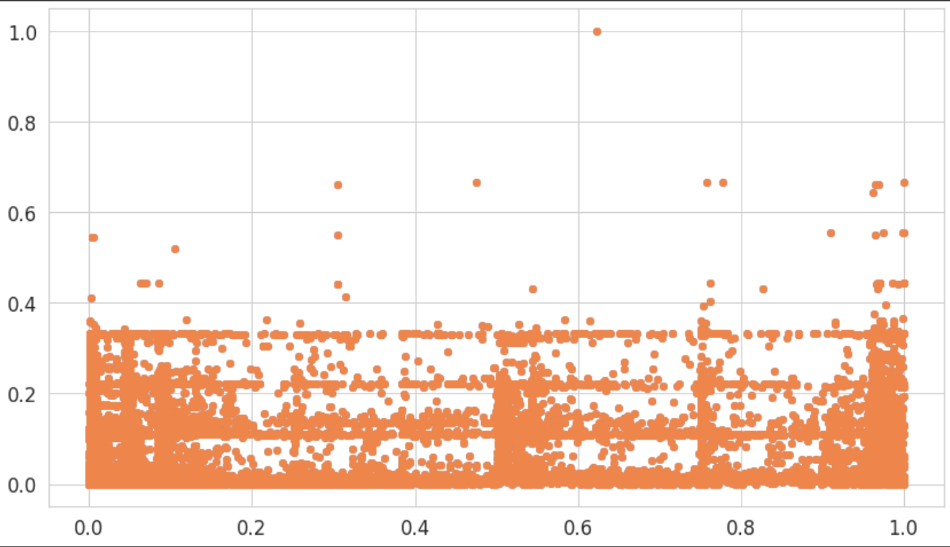
Network Flow Data Anomaly Detecting
데이터 전처리
Min-Max Scaler - 표준화

Slide 6
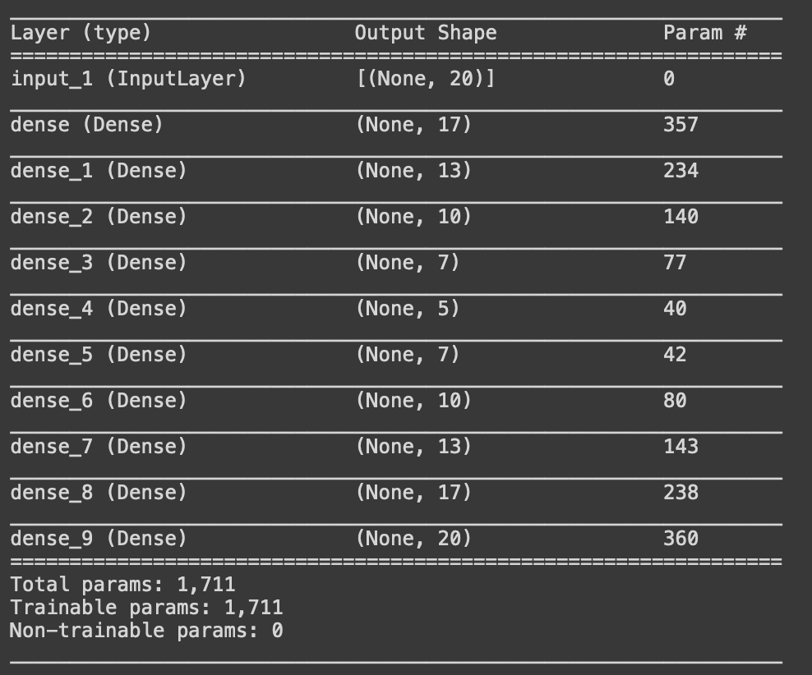
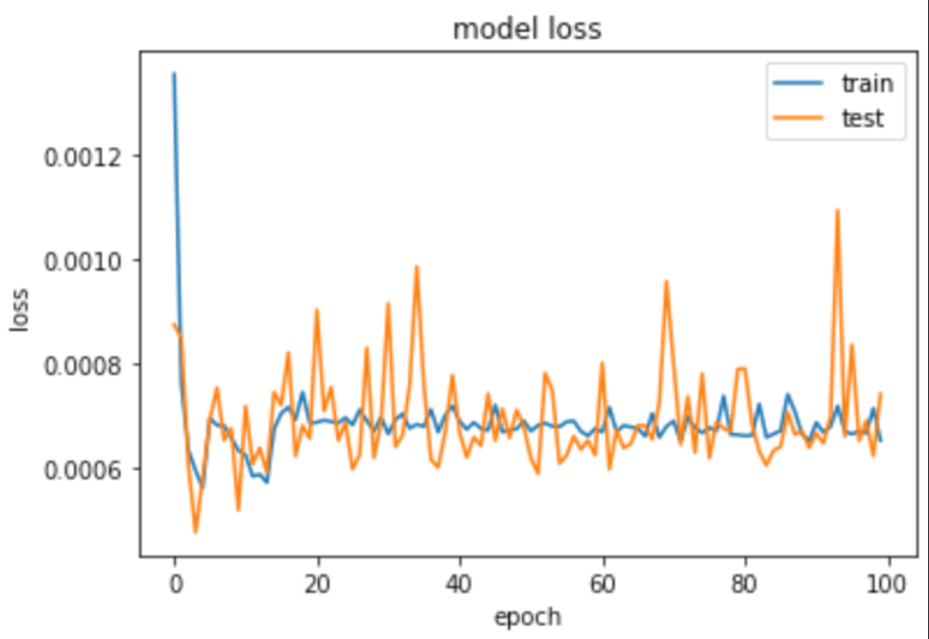
Network Flow Data Anomaly Detecting
AutoEncoder
학습 , 성능

Slide 7
Network Flow Data Anomaly Detecting
AutoEncoder
학습 , 성능

Slide 8
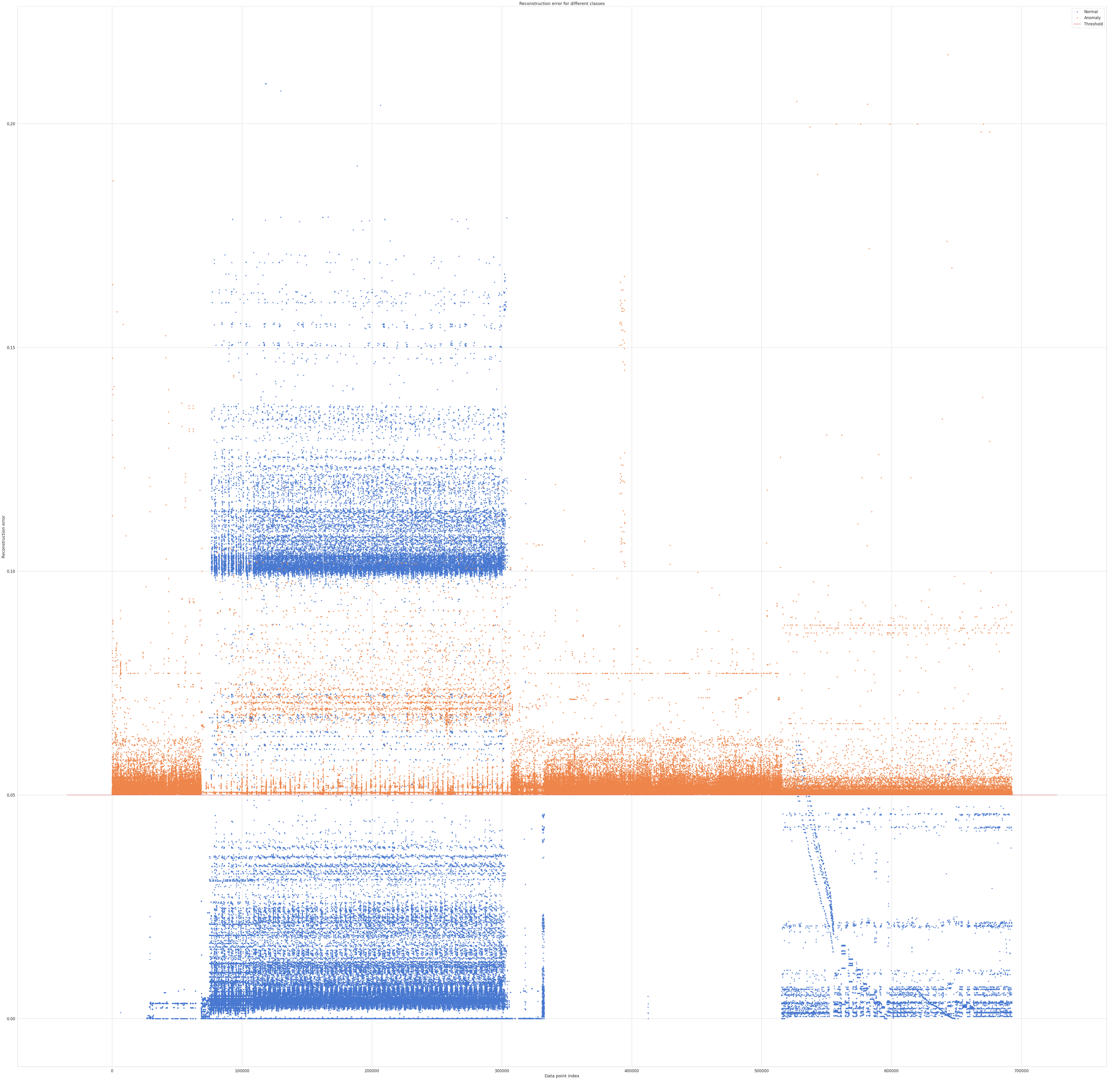
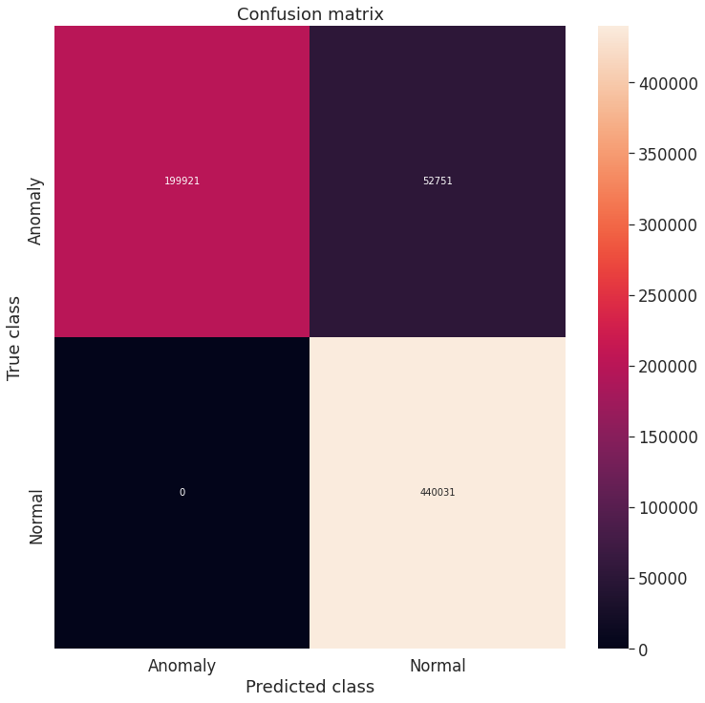
Network Flow Data Anomaly Detecting
AutoEncoder
Loss 시각화 , Confusion Matrix

Slide 9
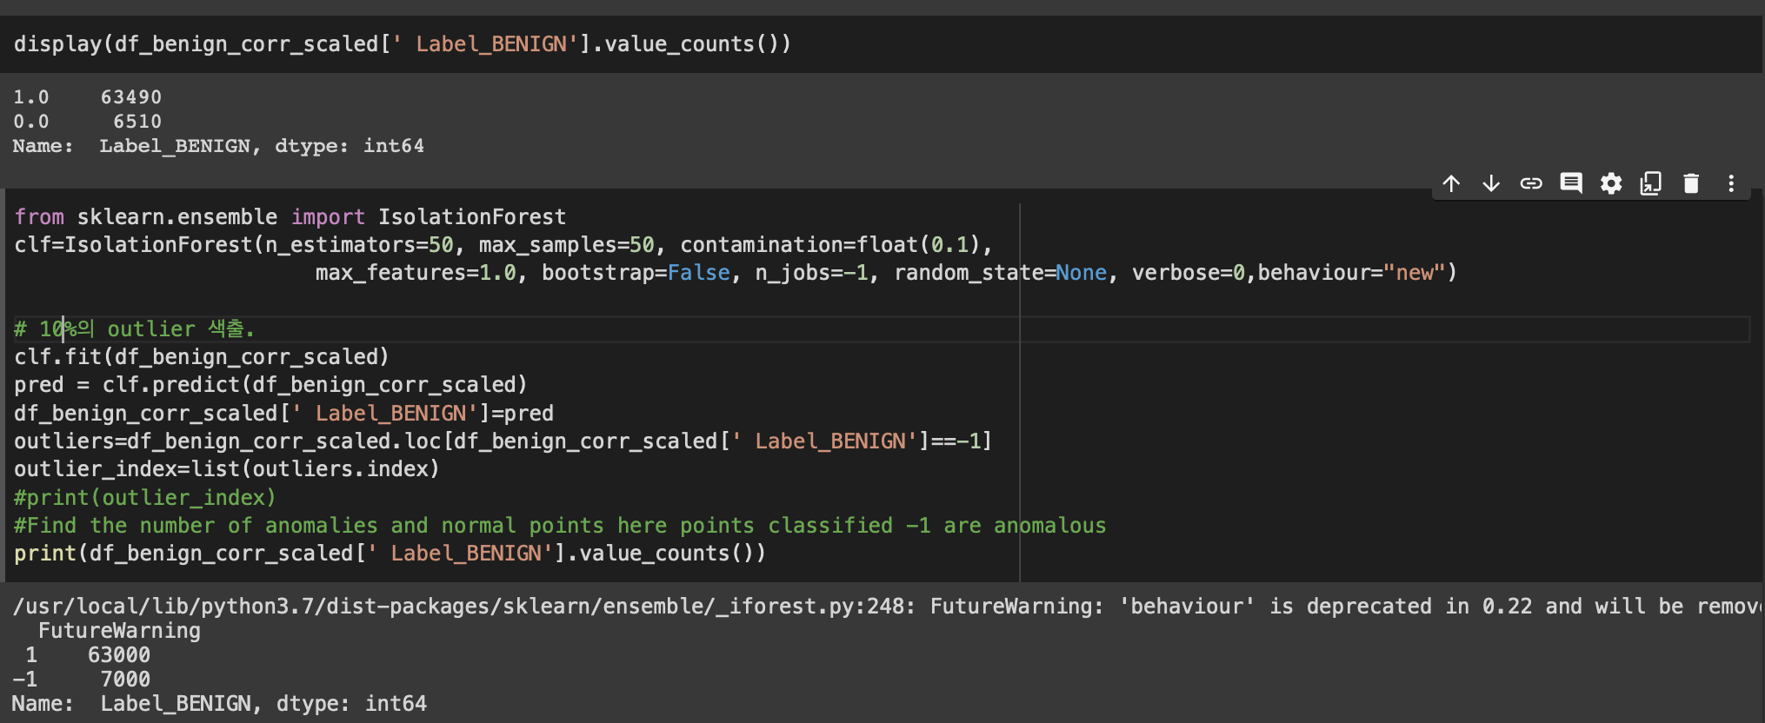
Network Flow Data Anomaly Detecting
Isolation Forest
분류

Slide 10
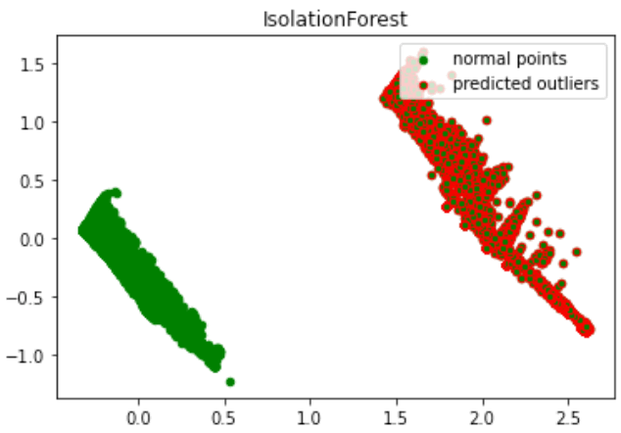
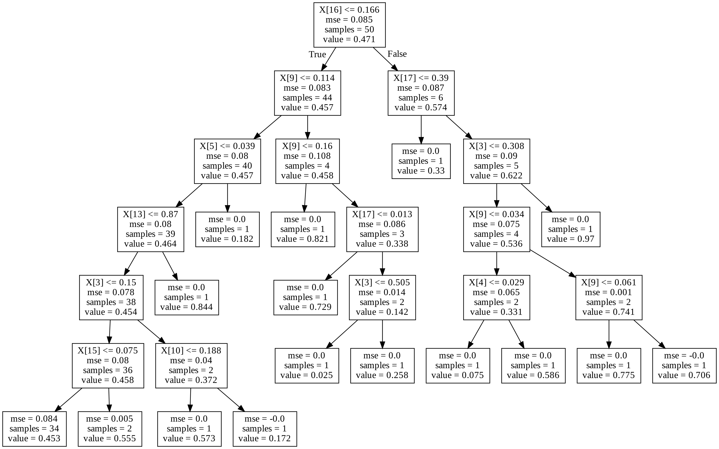
Network Flow Data Anomaly Detecting
Isolation Forest
시각화

Slide 11
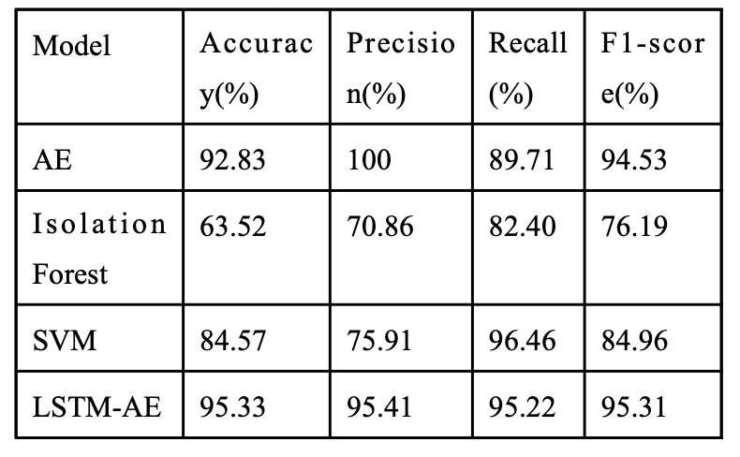
Network Flow Data Anomaly Detecting
결론

